Slide 1


Slide 2

#LifeKoKaroLift
SGC Coaching:
Articulate your Journey | Activate Your Vigour| Accelerate Mutual Growth
Session 19
Word Embedding

Slide 3
Agenda
Quick Recap – (15 min)
Focused Teaching (60 min)
Doubts Resolutions (15 min)
Word Embedding
doubts resolutions
Last 2 weeks

Slide 4
Recap: What the learner have learnt in the week
Quick Glance at Key Learnings
Word Embedding
Embedding Methods
Basics
When to use
What is
When to use
Word2Vec
Glove
Custom Embedding

Slide 5
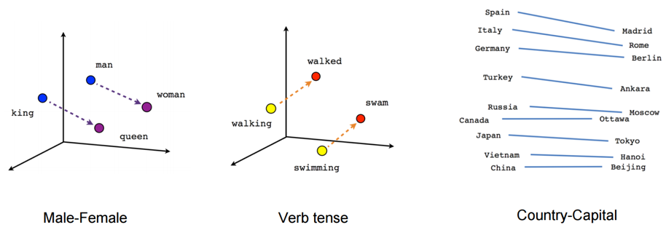

Word Embedding
Stores each word in as a point in space, where it is represented by a dense vector of fixed number of dimensions (generally 300) .Unsupervised, built just by reading huge corpus
vector[Queen] $≈$ vector[King] - vector[Man] + vector[Woman]
vector[Paris] $≈$vector[France] - vector[ Italy] + vector[ Rome]
This can be interpreted as “France is to Paris as Italy is to Rome”.

Slide 6
Word Embedding
Applications
Word Similarity
Machine Translation
Part-of-Speech and Named Entity Recognition
Relation Extraction
Sentiment Analysis
Co-reference Resolution
Chaining entity mentions across multiple documents - can we find and unify the multiple contexts in which mentions occurs?
Clustering
Words in the same class naturally occur in similar contexts, and this feature vector can directly be used with any conventional clustering algorithms (K-Means, agglomerative, etc). Human doesn’t have to waste time hand-picking useful word features to cluster on.
Semantic Analysis of Documents
Build word distributions for various topics, etc.

Slide 7
Coding Time
Coding Time

Slide 8

Doubts Resolutions

